Slide 1
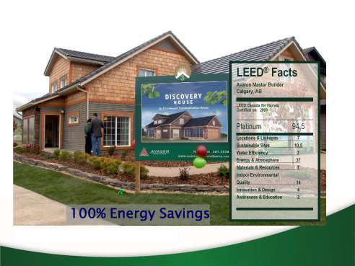
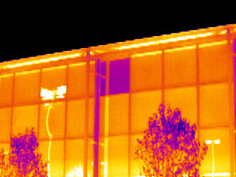
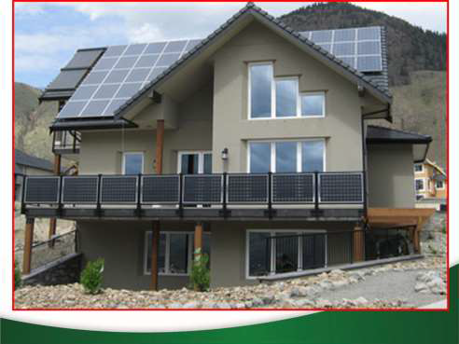
Building Sustainability – “Leave only Footprints”
PEO Presentation
Nov 5, 2014
Dan Vivian, P.Eng.
Principal – Building Science Trust Inc.
buildingsciencetrust@gmail.com

Slide 2
About Me
Waterloo 85 Mech. Eng Grad
University of Ottawa Chemical Engineering Graduate Student
P.Eng. 1988
17 yrs manufacturing (project, plant engineering, maintenance supervision)
8 years Property Condition Assessment, evaluated over 450 buildings
4 years energy engineering energy specialist in primarily in buildings and mining
2 years Principal – Building Science Trust Inc.
Currently Employed at Cleland Jardine Engineering since Sept. 22
Notes:
450 Buildings – know how buildings are put together by decade and function

Slide 3
What I’m going to speak about?
The “State of the Art” of Existing Building Sustainability (Maintenance, Energy and Operating Costs)
And how to move existing buildings to Net Zero Energy and Excellent Sustainability

Slide 4
Building Energy Significance
Approximately 40% of energy usage in North America is buildings related!
LEED Canada has over 4,000 LEED Buildings Registered
Approximately 160 commercial Net Zero in North America now and growing.
Premium for NZB residential 15%
Current Ottawa builder – Minto “Inspiration Eco-home”
Notes:
Define NZB

Slide 5
Overall Building Life Cycle Costs
Capital depreciation (embedded energy)
Operating energy
Maintenance
Taxes
End of Life Remediation and disposal
Administration
Notes:
Approximately in order of most to least significant for most buildings and I’ll talk about the first three.

Slide 6
Maintenance Process
Once the keys are handed over to an owner we are in the maintenance mode.
A smart way of maintaining a building is by capital planning with a Property Condition Assessment
Property Condition Assessments (a building survey and report to establish the condition of building components and their remediation) (their replacement or repair)
An Energy Audit and Plan can be Simultaneously Provided.
Notes:
PCA function is the same if the owner (building management) does it or outside consultant

Slide 7
What is a PCA?
PCA - Property Condition Assessment (Report), addresses capital depreciation and maintenance costs
Deficiencies are identified by age and or condition and reported within a specified time frame usually typically 7 to 12 years (refinancing, pre-purchase, capital planning) 30 year for Condo Reserve Fund Studies
Notes:
Specified time range can be 5 to 20 years or more. I have my doubts about the usefulness of greater then 12 years and (HERE IS A FIRST) I think less then 5 years for an independent consultant may be overspending.

Slide 8
PCA’s Continued
Based on the condition of a component which has exceeded it’s EUL an assessor may recommend earlier or later replacement
Based on poor condition, an assessor may recommend early replacement
Observed safety related concerns are also indicated to an owner
Not specifically a code or safety study – those are more expensive and look at specific items
PCA’s are usually limited with provisions – i.e. not a fire and life safety study, not a DSS (asbestos, lead, mercury…), not a fresh air study, not an environmental study…
Notes:
Depending on experience assessor may recognize many of the specialist issues and make verbal or written recommendations for these.

Slide 9
PCA - Continued
A PCA typically documents costs estimate recommendation with “like for like” replacements of deficient components

Slide 10
Deficiencies Photo Collection (Break)

Slide 11
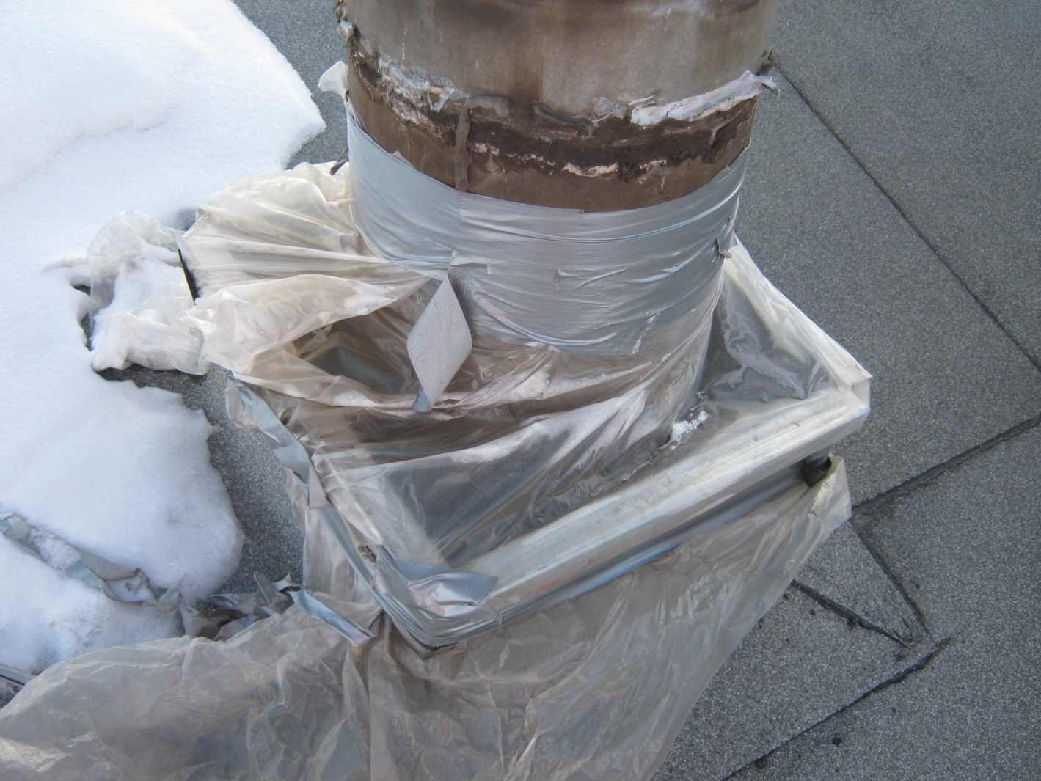
Pretty Obvious Issue
(approximately
1.5 year old
temporary repair)

Slide 12
Pretty Obvious HVAC Issues
Seriously deteriorated ducting and RTU - clearly abandonned

Slide 13
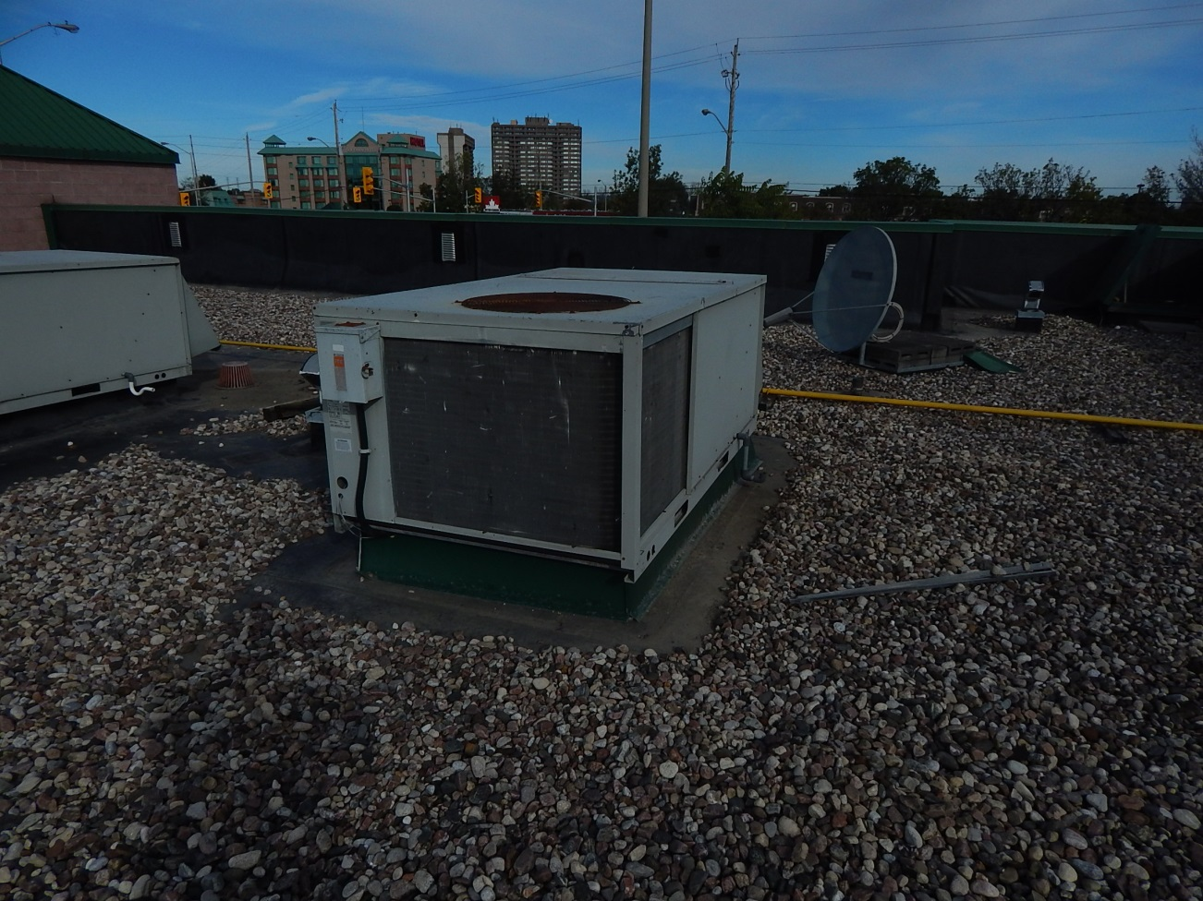
Greyer Area
Issues with roof and RTU
Notes:
The RTU is approximately 24 yo, roof likely the same, RTU EUL is 25 years, Roof 23, suspected issues with long term moisture infiltration, unknown interior damage

Slide 14
For Energy Audits
Energy Audits make improvement recommendations above and beyond a simply “like for like” replacement and can provide the upgraded costs, savings paybacks (ROIs) and sometimes GHG reduction estimates

Slide 15
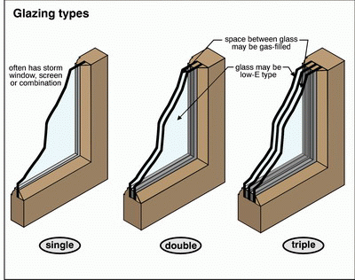
Typical Improvement (ECM)
Notes:
Depending on the performance orientation and location window design changes – poor, better, best, south vs north solar gain, heating dominated vs cooling dominated climate, insulating blinds

Slide 16
Change Insulation from R7 to R23

Slide 17
20,000 SF Office Commercial/Institutional
839 Shefford Rd, Gloucester, ON
Notes:
Very familiar with this building – did a PCA about 4 years ago, wasn’t able to provide an EA - yet

Slide 18
2 Air Conditioning RTU (~ 10 Ton)
Notes:
Building has 2 AC only RTU’s about 10 ton each

Slide 19
Sustainability Analogy
the farmer’s hammer

Slide 20
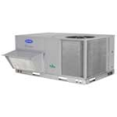
Lifetime 10 Vs 5 RTUs

Slide 21
What is the Path to Improvement?

Slide 22
Current Criteria for Design in North America
Mostly Follow Minimum Building Code
Suggest we Switch to a Holistic Approach
Include “Total Investment” including Future Sustainability

Slide 23
Sustainability Definition?
Sustainable development is development that meets the needs of the present without compromising the ability of future generations to meet their own needs

Slide 24
Sustainability Implications
Concept is a generation uses available resources without (“adverse”) implications for the following generations
More sustainable – less generational adverse consequences
Notes:
Careful negative may be subjective

Slide 25
Low to No Environmental Pollutants (Adverse Generational Effects)
The Goal is Low to No;
Ozone Depleting Gases
Green House Gases (Climate Warming)
(Unsustainable ) Radioactive Waste
Plastic Pollutants with 10,000 year decomposition life
Hazardous Wastes, (asbestos, mercury, lead, PCBs, etc)
Etc…
Notes:
the goal is to minimize impacts recognize it is impossible to achieve

Slide 26
How to Proceed
Minimizing Energy Impacts Requires Choosing High Performance Building designs (LEED) and Existing Buildings Remediations
Net Zero Building (NZB) Design may be required to reach the goal of generational sustainability
Notes:
Concern about waste issues with extensive infrastructure

Slide 27
Typical NZB Design Process
Apply High Performance Energy Conservation Techniques
Add Renewable Energy Generation

Slide 28
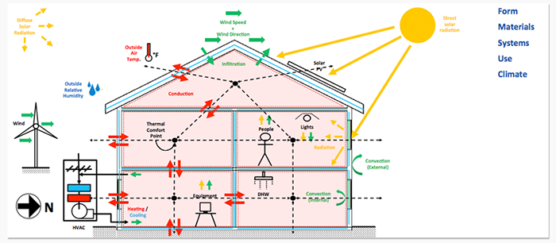
Building Heat Flow Diagram
Notes:
Very Bust diagram conveys most important issues, Conduction through the Envelop, Fresh Air, Solar Gains, Internal Gains (lights, appliances equipment, people)

Slide 29
Conservation to Reduce Loads
Use existing Best Techniques of the Passive House and Solar Energy People
Highly Insulate (10% ROI)
Use VOD or Occupancy Control (ROI and TI varies depending on occupancy but sometimes very high), Energy Recovery (ERV, HRV), (~20% ROI)
Lower internal gains
LED or CFL lighting from incandescent, halogen, HID (eg. incandescent to LED, ~30% ROI)
High efficiency appliances (eg. CRT tv to Flat Screen)
– Reduces Energy Loads by 50 to 70%

Slide 30
Now Add Renewable Generation to go to Net Zero Design
Solar PV
Solar Thermal
Energy Storage (to get through November Greys)
GSHP?
Wind?
Other..

Slide 31
NZB Economics
Cost ~ Adds $30/FT2, new or existing buildings
10 to 20% new house cost
ROI ~ 10 yr or 10%

Slide 32
When to Apply these Conservation Techniques?
A PCA identifies the present State of the building’s components
An Energy Audit Identifies the Possibilities for the best Improvement
Join these two efforts to encourage owners to retrofit Existing Buildings (EB) to higher performance or design new buildings to a higher level of performance

Slide 33
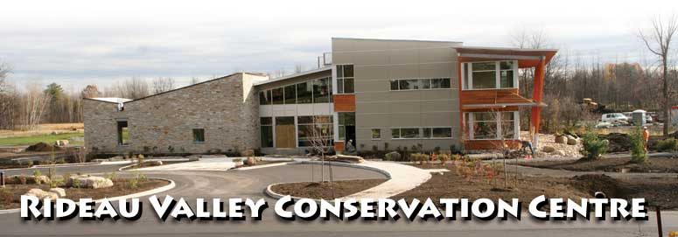
Local LEED Building

Slide 34
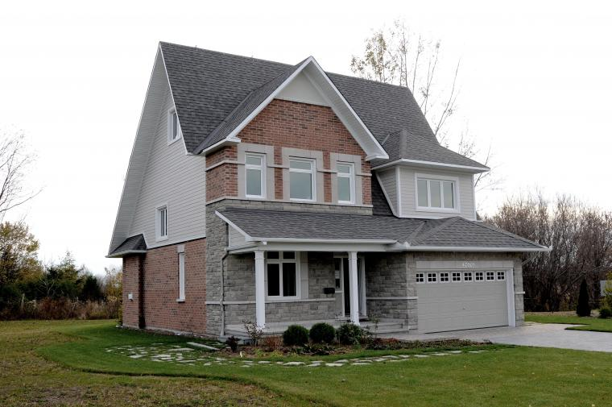
Local NZB House

Slide 35
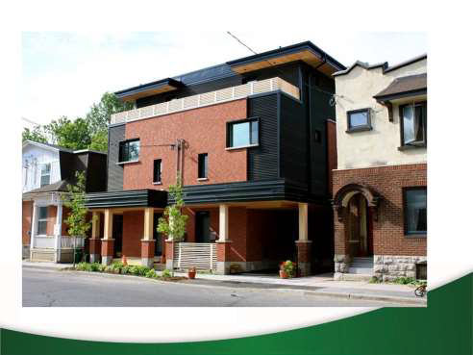
Local HPB
While right here in Ottawa we have the first Passive House residence in Canada, designed and built by owner Chris Straka of Vert Design and certified by the Passive House Institute of the US.
Slide courtesy Ross Elliott

Slide 36
Economic Impediments
Initial Cost
10 year Paybacks
Financial Risk for an owner who my sell

Slide 37
Financing Solutions
PACE Programs (Started in California, available in about 30 US States, Some Canadian Cities – Local Improvement Charges)
Tie Energy Loan Payments to Taxes
Energy Savings Exceed Loan Costs
When the building is sold the new owner assumes the registered loan and continues to pay it off in the building taxes

Slide 38
Summary
To Move to a Higher Level of Sustainability we;
1
Perform a PCA/EA
Identify Deficient Components
Upgrade with NZB ready Designs
2
Add Sustainable (Renewable) Energy
3
Be Assured that you have done your best for future generations

Slide 39
Building Sustainability Course
Offered - January 10th,17th and 24th
$799 per person
Go to
buildingsciencetrust.com
for course details and a copy of this presentation or to request information

Slide 40
Questions?

